Slide 1
Forest Cover Type Prediction
Group5:Rayna Liu, Yuan Meng, and Zheyue Wang

Slide 2
01
02
INTRODUCTION
DATA PROCESSING
03
04
MODEL SELECTION
CONCLUSION
Content

Slide 3
01
Introduction
Introduce our project

Slide 4
Experiment Objective
To predict the forest cover type (the predominant kind of tree cover) from strictly cartographic variables.
This study area includes four wilderness areas located in the Roosevelt National Forest of northern Colorado.
Notes:
The data is in raw form (not scaled) and contains binary columns of data for qualitative independent variables such as wilderness areas and soil type.

Slide 5
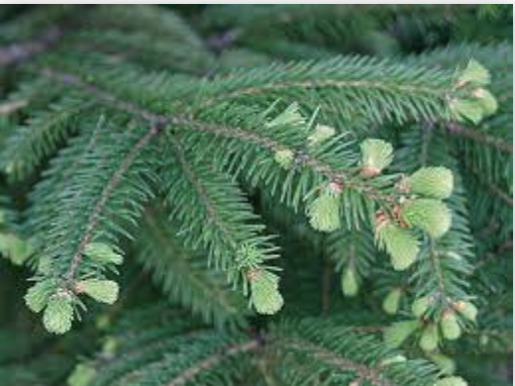
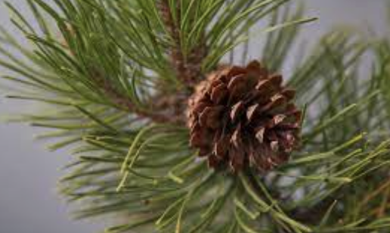
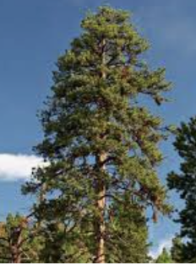
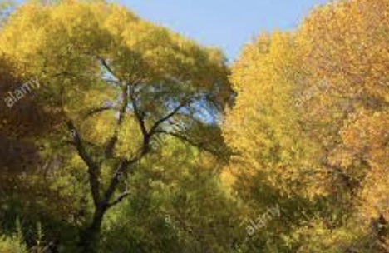
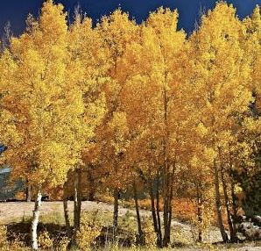
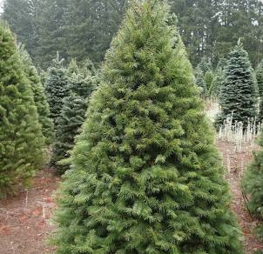
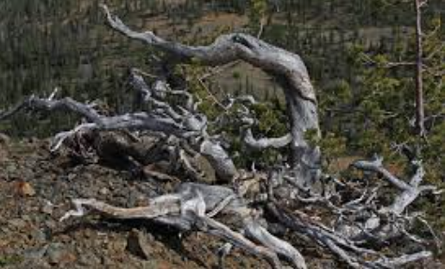
Introduction
For this project, we want to predict the type of trees that covered in the forest. Below is the target:
1 - Spruce/Fir 2 - Lodgepole Pine 3 - Ponderosa Pine 4 - Cottonwood/Willow
5 - Aspen 6 - Douglas-fir 7 - Krummholz

Slide 6
Introduction
Dataset:
The dataset is comes from the Kaggle.
In this dataset, we total have 15120 observations in training data, 565892 observations in test set.
Features:
Elevation 9. Wilderness_Areea
Aspect 10. Soil Type
Slope
Horizontal Distance to Hydrology Target:
Vertical Distance To Hydrology 11. Cover Type
Horizontal Distance To Hydrology
Hillshade (at 9am, at noon, at 3pm)
Horizontal Distance To Fire Points

Slide 7
Introduction
More detail:
For Wilderness areas, there are 4 types:
Rawah 2. Neota 3. Comanche Peak 4. Cache la Poudre
For Soil type, total has 40 types:
Here we just list 5 of them:
Cathedral family : Rock outcrop complex, extremely stony
Vanet : Ratake families complex, very stony.
Haploborolis : Rock outcrop complex, rubbly.
Ratake family : Rock outcrop complex, rubbly.
Vanet family : Rock outcrop complex, rubbly.
………………..

Slide 8
02
DATA PROCESSING
Follow the pipeline for Classification

Slide 9
The Pipeline of Data Preprocessing for Classification
Splitting the data
Loading the data
Handling identifiers
Handling Uncommon features
Training Set: 15,120 observations, contains both features and the Cover Type (56 columns)
Testing set: 565,892 observations, contains only the features (55 columns)
Divide the training data into 80% training (12,096 observations) and 20% validation (3,024 observations)
Removing Identifiers in training, validation, and test set
No uncommon feature in training, validation, and test set

Slide 10
The Pipeline of Data Preprocessing for Classification
Handling date time variables
Handling missing data
Handling Class Imbalance
Scaling the data
Splitting the feature and target
No date time variables
No missing data
No categorical variables need to be encoded
Encoding the data
Setting the class_weight hyperparameter as ‘balanced’
Standardizing the training, validation, and test set
Get the feature matrix and the target vector

Slide 11
03
MODEL SELECTION
Explore 8 different models to find the best one

Slide 12
Model Selection Pipeline
CLASSIFIERS
Hyperparameters
GridSearchCV
Create a dictionary of the models.
Adjust Parameter grids for each classifiers.
Update best scores of params estimator, and sort results in ascending order.

Slide 13
Classifiers
KNeighborsClassifier | MLPClassifier | HistGradientBoosting Classifier
DecisionTreeClassifier | RandomForestClassifier | ExtraTreesClassifier
LogisticRegression | SVC

Slide 14
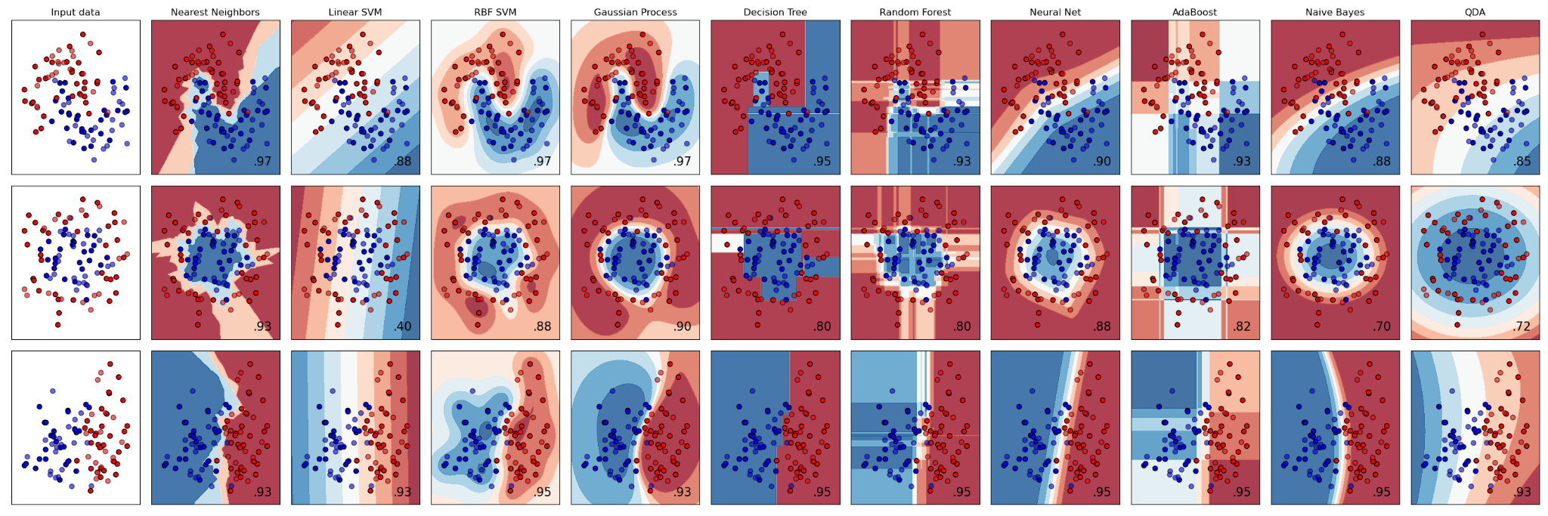
Decision Boundaries

Slide 15
Hyperparameters
KNN
n_neighbors
algorithm
ETC
n_estimatorsint
max_depthint
LR
tol
C
MLPC
alpha
learning_rate_init
SVC
decision_function_shape
DTC, RFC, HGBC
min_samples_split
min_samples_leaf

Slide 16
Results
0.88
0.88
0.87
0.82
0.81
0.79
0.75
0.71
ExtraTreeClassifier
SVC
LogisticRegression
MLPClassifier
DecisionTreeClassifier
RandomForestClassifier
KNeighborsClassifier
HistGradientBoostingClassifier

Slide 17
BEST MODEL ANALYSIS
Elevation
Fire Points
Wilderness Area 4
Roadways
Elevation in meters
Importance 0.184323
Horz Dist to nearest wildfire ignition points
Importance 0.0560241
Cache la Poudre Wilderness Area
Importance 0.101644
Horizontal distance to nearest roadway
Importance 0.0700632

Slide 18
04
Conclusion

Slide 19
Conclusions
Since Extra tree Classifier has the best score, we choose extra tree classifier as our model. Elevation in meters, wilderness area types, and the horizontal distance to nearest roadways, fire points, and surface water are the most important features of our model.

Slide 20
Thanks!
Work Cities:
https://www.kaggle.com/c/forest-cover-type-prediction/data
https://github.com/yuxiaohuang/teaching/tree/master/gwu/machine_learning_I/spring_2021
https://scikit-learn.org/stable/auto_examples/classification/plot_classifier_comparison.html
]]

